Slide 1
GROUP 8 · CEF 440 · UNIVERSITY OF BUEA
FINAL PRESENTATION · TASK 7
CarDiag
Your pocket diagnostic.
An AI-based mobile application for car fault diagnosis — it reads dashboard warning lights and
engine sounds and explains them in plain language, on-device and fully offline.
On-device AI
Offline-first
Assistant, not a replacement
No OBD hardware
Notes:
Good morning. We are Group 8, and this is CarDiag — an AI-based Android app that turns the phone you already own into a first-level car diagnostic assistant. It reads dashboard warning lights and engine sounds and explains them in plain language, fully offline. Today we'll show you how the finished application actually works.

Slide 2
WHY IT MATTERS — THE PROBLEM
Drivers can't read what their car is telling them.
Cameroon's roads run mostly on ageing imported vehicles that constantly report faults — through dashboard warning lights and engine sounds. A trained mechanic reads them in seconds; the ordinary owner only knows the car "sounds wrong," and often ignores it until a cheap fix becomes a costly breakdown.
83.3%
66.7%
85.2%
had seen a dashboard warning light they did not understand
ignored a warning light purely because they didn't understand it
heard an unusual engine sound they could not identify
Measured, not assumed — survey of 54 drivers + 7 professional mechanics.
Notes:
First, why this matters. In Cameroon most cars are older imports that constantly signal faults — but the average driver can't read those signals. We measured it: in our survey of 54 drivers, 83% had seen a warning light they didn't understand, two-thirds had ignored one because of that, and 85% heard an engine sound they couldn't place. Ignored faults become expensive breakdowns.

Slide 3
WHAT IT DOES — THE SOLUTION
A first-level diagnostic assistant, built into the phone you already own.
Scan a warning light
Listen to the engine
Answer guided questions
Point the camera at the symbol. On-device vision recognises it and explains what it means.
Record a short clip. Audio analysis classifies the sound into a likely fault family.
No camera or sound? A short questionnaire produces a preliminary assessment.
Every pathway returns:
Plain-language cause
Urgency level
Safe next step
A WALKTHROUGH →
Home
Scan
Listen
Result
Repair
Garage
Offline
Notes:
CarDiag closes that gap using the phone the driver already owns — no OBD dongle, no internet needed. Three pathways: scan a warning light with the camera, record and analyse an engine sound, or answer guided questions. Each returns the same thing: a plain-language cause, an urgency level, and a safe next step. The rest of this presentation is a walkthrough of exactly how the app does that.

Slide 4
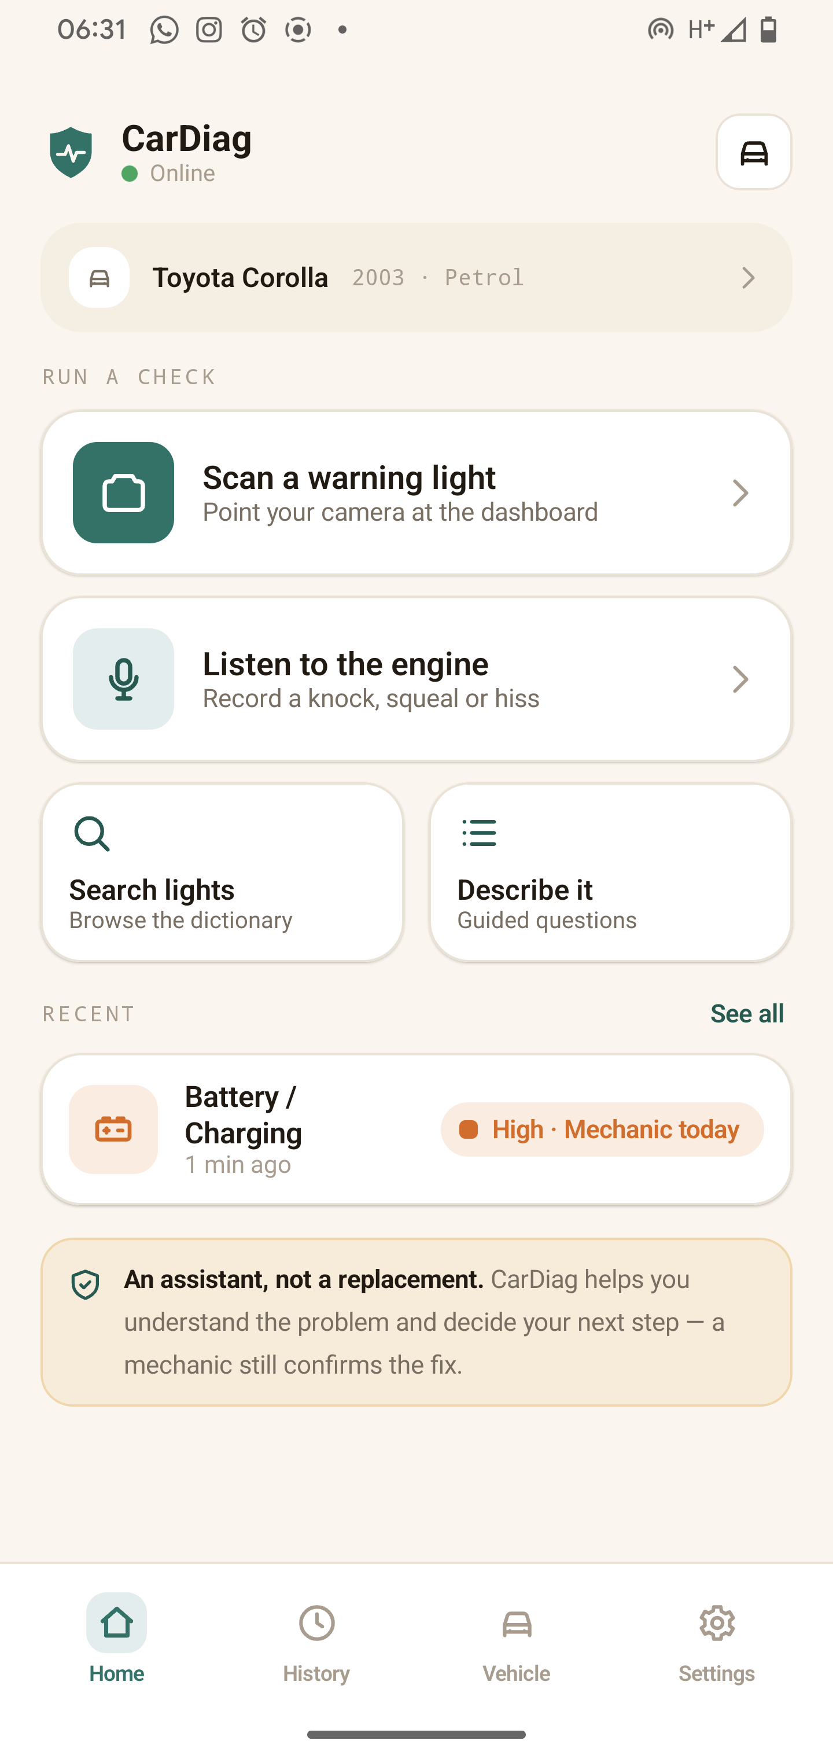
HOW IT WORKS · 01 — THE HOME HUB
Everything starts from one simple home.
Three ways in
Scan a warning light · Listen to the engine · Guided symptoms — as large, plain buttons.
Your active vehicle
Shown at the top so results can be filtered to your make, model and engine.
Recent result & offline badge
Jump back to your last check — and a clear indicator that the app works with no connection.
Notes:
When you open CarDiag, everything is one tap away. The home hub gives you the three diagnostic pathways as big, clear buttons. At the top is your active vehicle, so results can be tailored to your car. Your most recent result sits right there to return to. And notice the offline indicator — the app tells you plainly that it works with no connection.

Slide 5
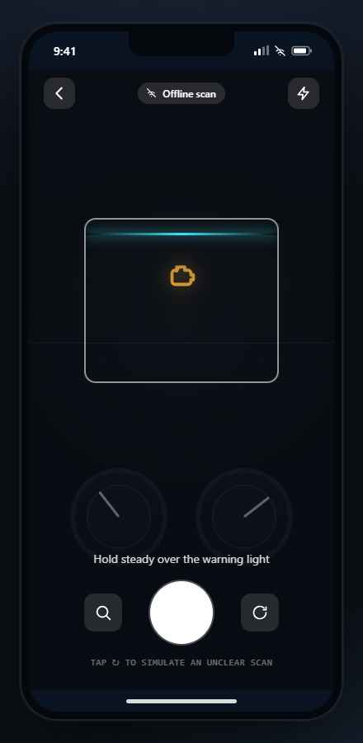
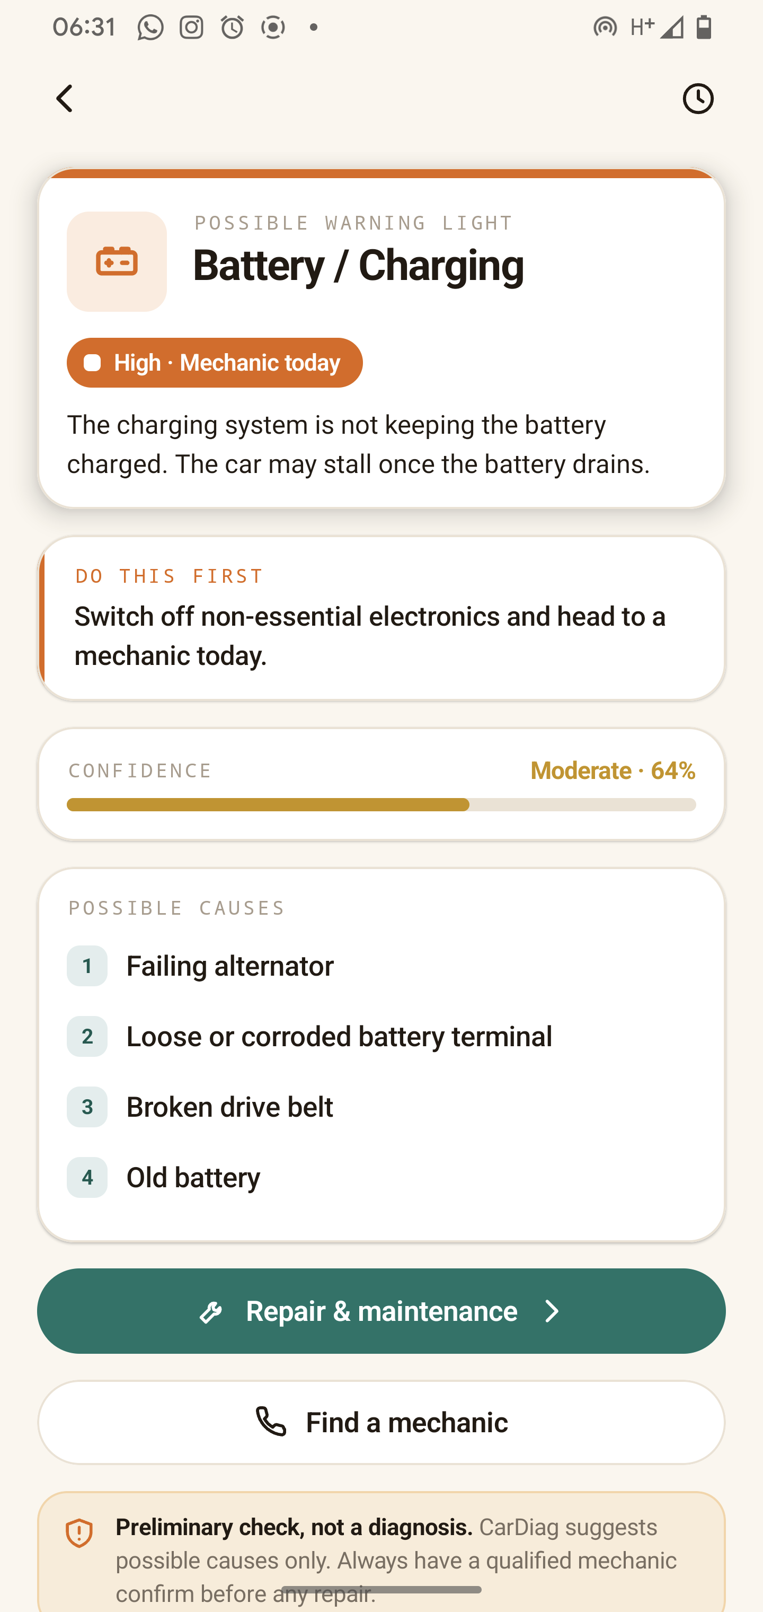
HOW IT WORKS · 02 — SCAN A WARNING LIGHT
Point, capture, understand — in seconds.
1
Aim — align the light in the reticle; on-device vision identifies it in <1s, offline.
2
Name & meaning — what the symbol is, in words a non-technical driver understands.
3
"Do this first" — the single safe action to take right now.
4
Confidence meter — how sure the app is; if it's low, the fault name is hidden.
5
Possible causes — ranked in plain language, most likely first.
Aim & capture
Plain-language result
Notes:
Here's the first pathway in action. You aim the camera at the dashboard symbol — an alignment reticle helps you frame it — and the on-device model recognises it in under a second, completely offline. The result comes back in plain language: the name and what it means, a 'do this first' action, a confidence meter, and the ranked possible causes. No trouble codes, no jargon.

Slide 6
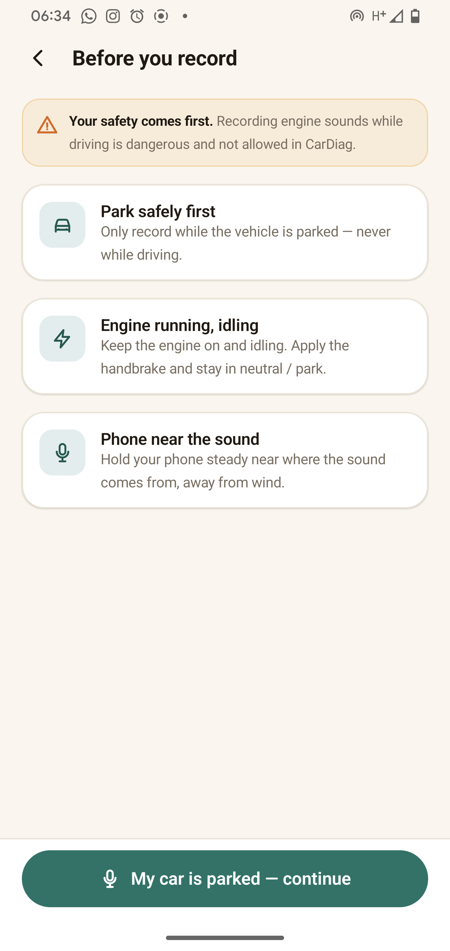
HOW IT WORKS · 03 — DIAGNOSE AN ENGINE SOUND
Let the app listen — safely.
1
Safety gate — confirm you're safely parked; the continue button is time-locked so it's actually read.
2
Ambient check — the app makes sure it's quiet enough to record a usable clip.
3
Record — a short clip through the microphone, on-device only.
4
Assessment — classified into a likely fault family, refined by follow-up questions, with a confidence score.
Notes:
The second pathway lets the app listen to the engine. Because recording near a running engine has to be done safely, it's gated: first you acknowledge a safety screen whose continue button is time-locked, then the app checks the surroundings are quiet enough. You record a short clip, and on-device audio analysis classifies it into a likely fault family — knocking, squealing, hissing and so on — with a few follow-up questions to refine it and a confidence score. It never names a fault it isn't sure of.

Slide 7
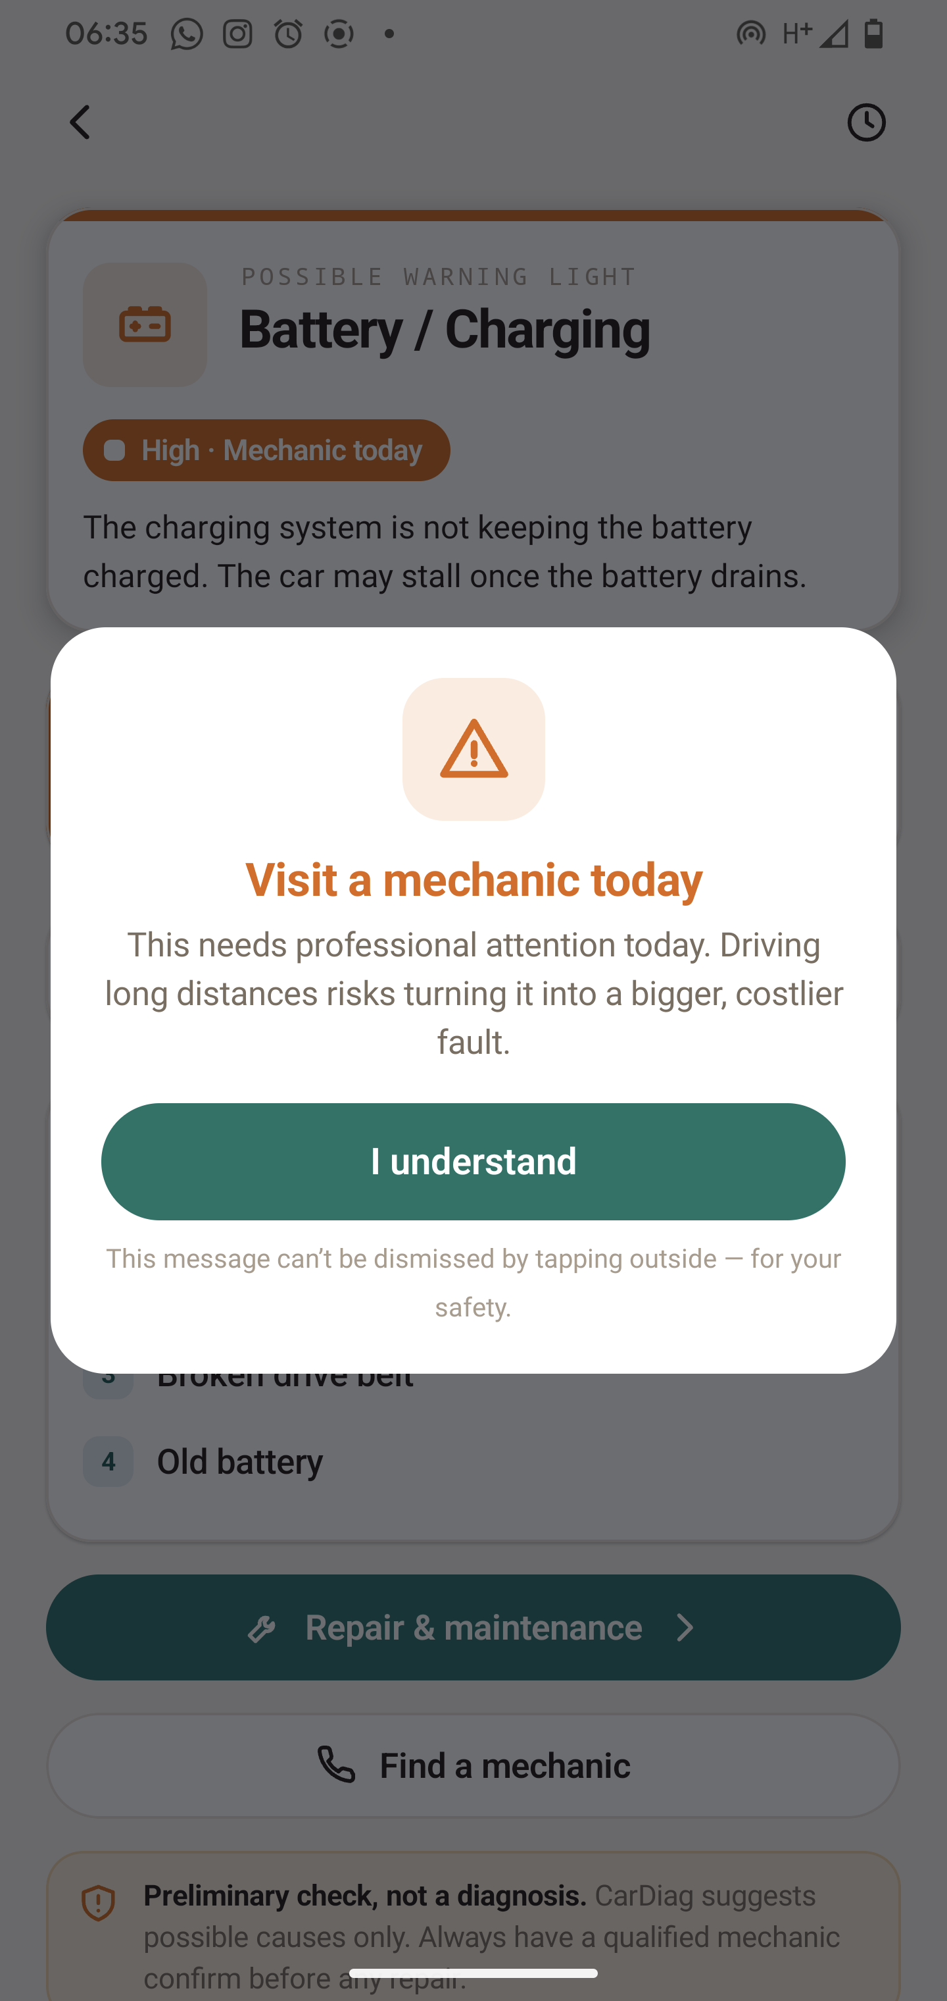
HOW IT WORKS · 04 — READING A RESULT
How urgent — and how sure.
Low
Medium
MONITOR
SERVICE SOON
High
Critical
MECHANIC TODAY
STOP NOW
Colour never alone — every level pairs a colour with a label and an action (WCAG AA).
Confidence + disclaimer — shown on every result; low confidence hides the fault name.
Critical faults: a non-dismissible prompt + one-tap mechanic call.
Notes:
Whatever pathway you use, every result is built the same way, and this is the heart of the app's trust model. Each result carries a four-level urgency scale — and crucially, urgency is never shown by colour alone; it always pairs a colour with a label and an action. There's a confidence meter, a safety disclaimer on every screen, and for High or Critical faults a non-dismissible prompt with a one-tap call to your saved mechanic. The app guides the decision; it never pretends to be the mechanic.

Slide 8
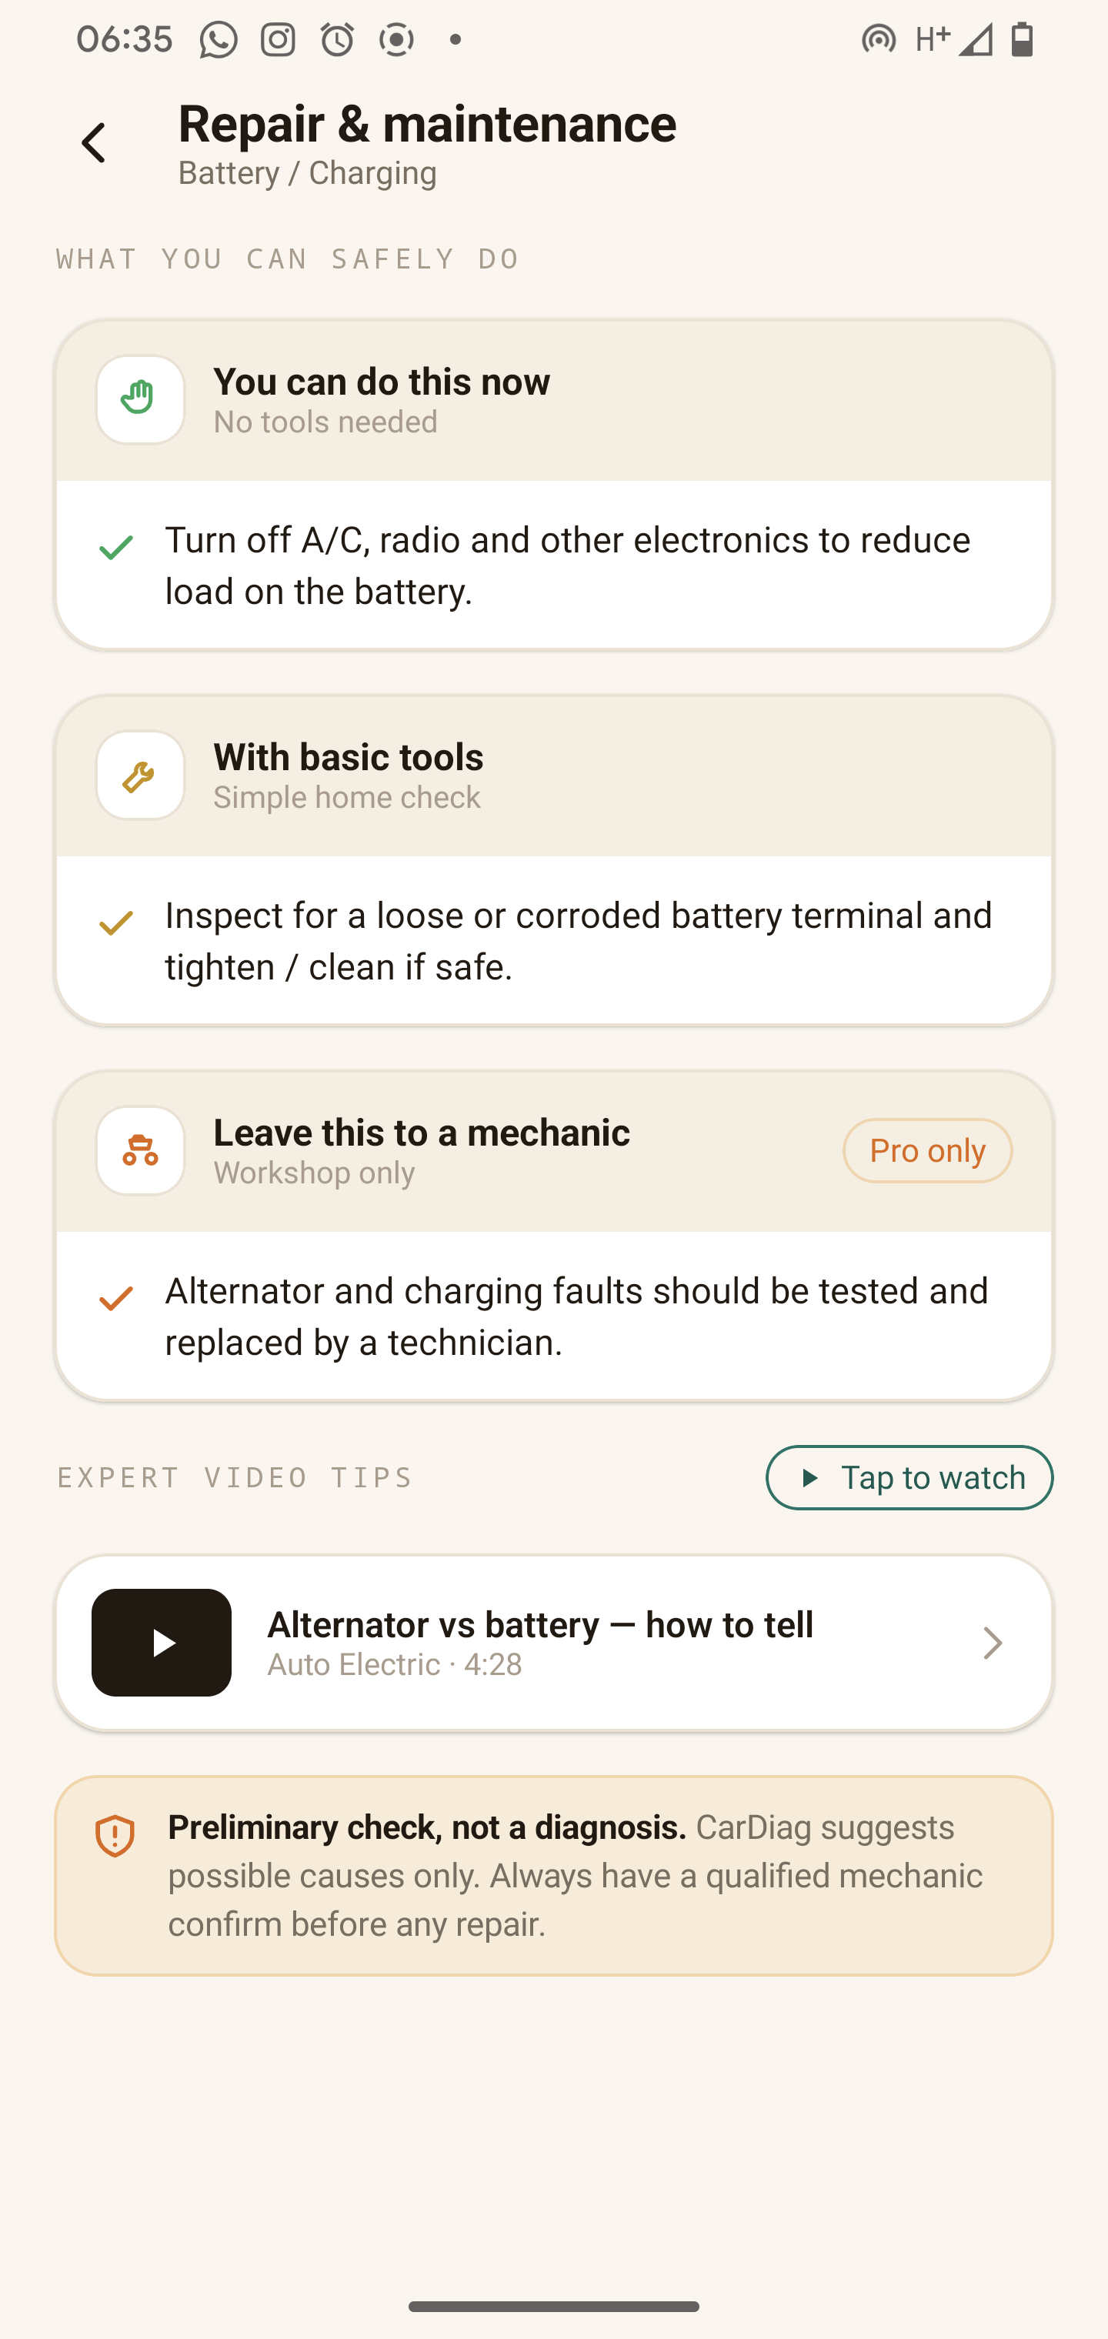
HOW IT WORKS · 05 — REPAIR & MAINTENANCE
Then it tells you what to do about it.
Safe to do yourself
Simple checks that need no tools at all.
With basic tools
Steps a confident owner can do with common tools.
Needs a workshop
Clearly flagged as a job for a professional mechanic.
Plus preventive tips, and curated expert video tutorials when you're online.
Notes:
Once you understand the fault, the app tells you what to do about it — responsibly. Repair guidance is split into three tiers: what's safe to do yourself with no tools, what needs basic tools, and what should only be handled in a workshop. It adds preventive maintenance tips so the fault is less likely to come back, and when you're online, curated links to expert tutorial videos. This is where the app is genuinely useful without ever encouraging an unsafe repair.

Slide 9
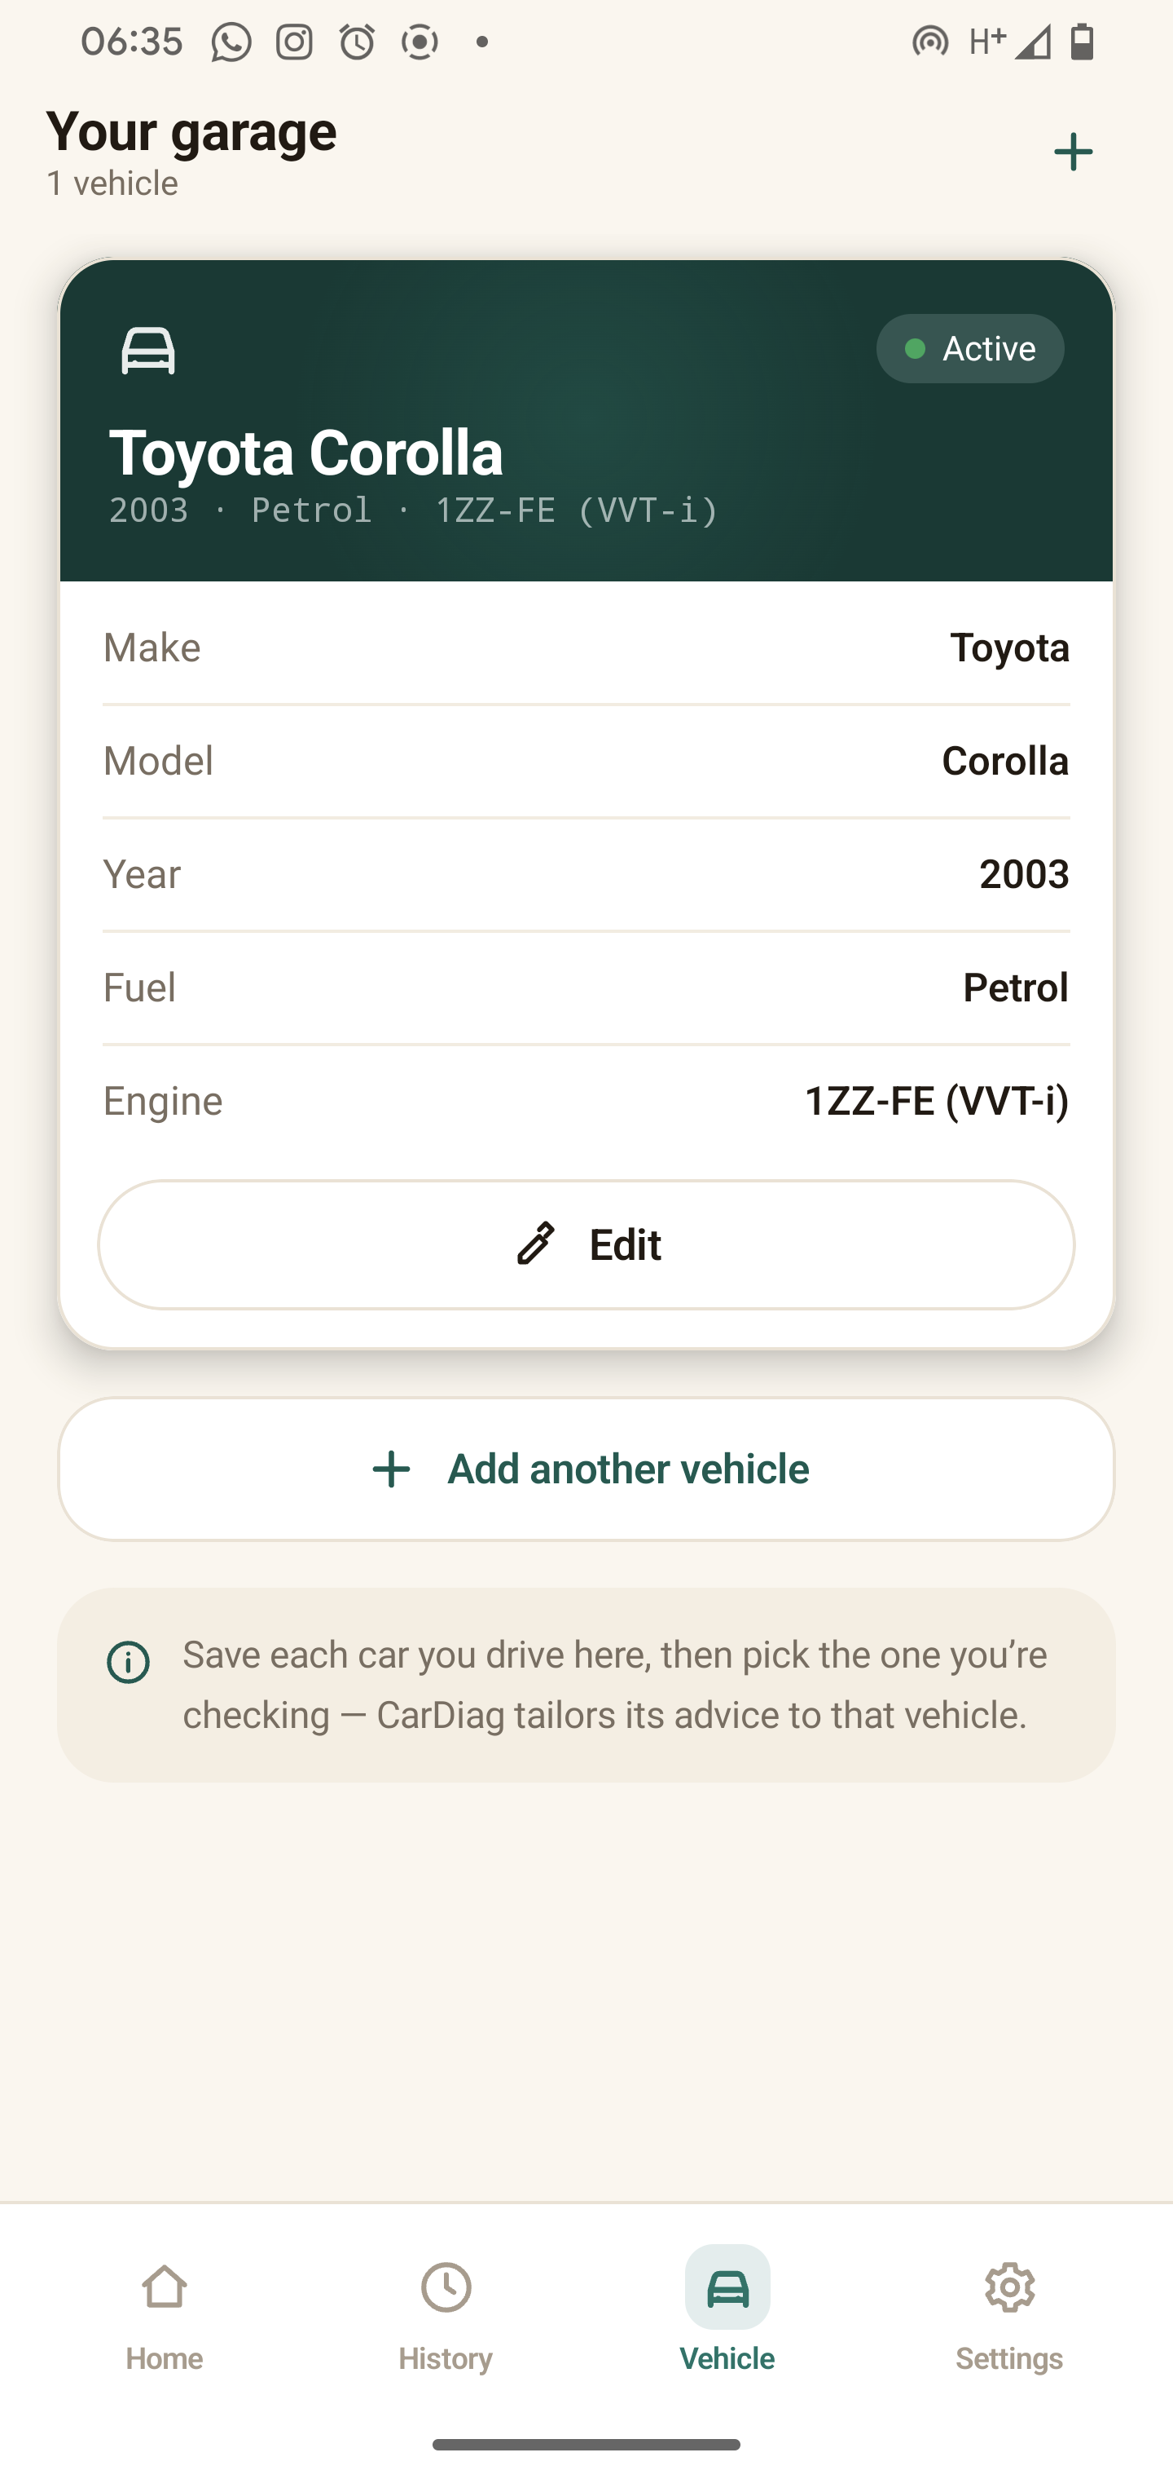
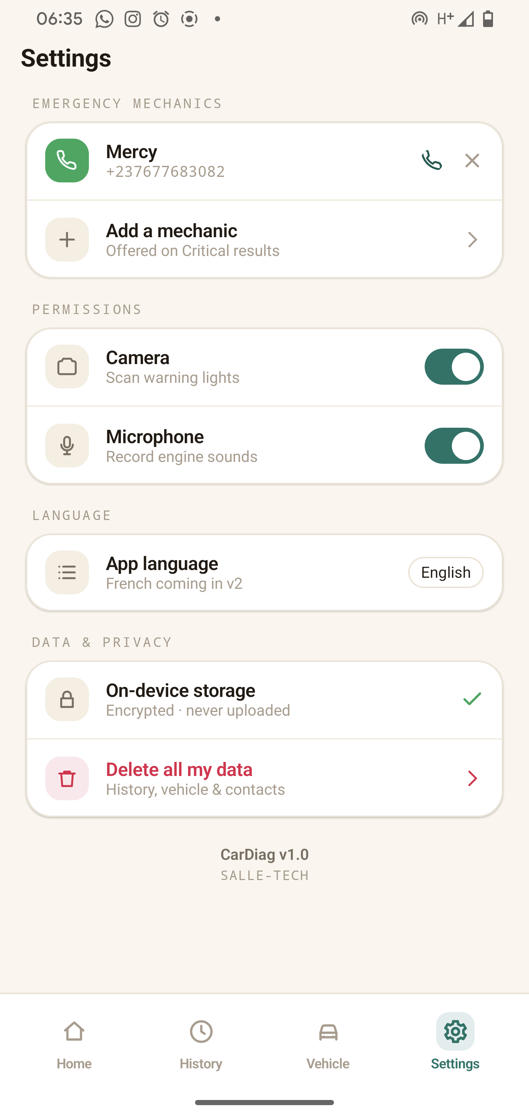
HOW IT WORKS · 06 — YOUR VEHICLES & DATA
It remembers your car — privately.
Vehicle garage
Save, switch and manage cars so results filter to your make, model and engine.
Diagnosis history
Every past check, with a note you can add — kept entirely on the device.
Settings & emergency contacts
Saved mechanic numbers for the critical prompt, permissions, and "delete all my data."
Vehicle garage
Settings
Notes:
The app also remembers your world — privately. You can save vehicles in a garage and switch between them so results are tailored to each car. Every past check is kept in a local diagnosis history. In Settings you save emergency mechanic contacts — the numbers offered in that critical prompt — manage permissions, and there's a 'delete all my data' option. Everything here is stored on the device; none of it is ever transmitted.

Slide 10
BUILT TO WORK ANYWHERE
No signal. No hardware. No problem.
Fully offline
On-device AI
Private by design
Core features work from first launch — no connection, no account.
A 0.59 MB model recognises warning lights in under a second.
Raw images and audio never leave your phone.
CarDiag
— your pocket diagnostic.
Group 8 · Salle Yimnai Bryan · Fongang Faith · Andigema Joyce · Manikeu Marie Ange · Ndip Samuel
Thank you.
Notes:
And this is what makes all of it work anywhere. Every core feature runs from first launch with no connection. The intelligence is a compact on-device model — under a megabyte — that recognises warning lights in under a second. And it's private by design: raw images and audio never leave your phone. No signal, no hardware, no problem. CarDiag — your pocket diagnostic. Thank you; we're happy to take questions.

